Slide 1
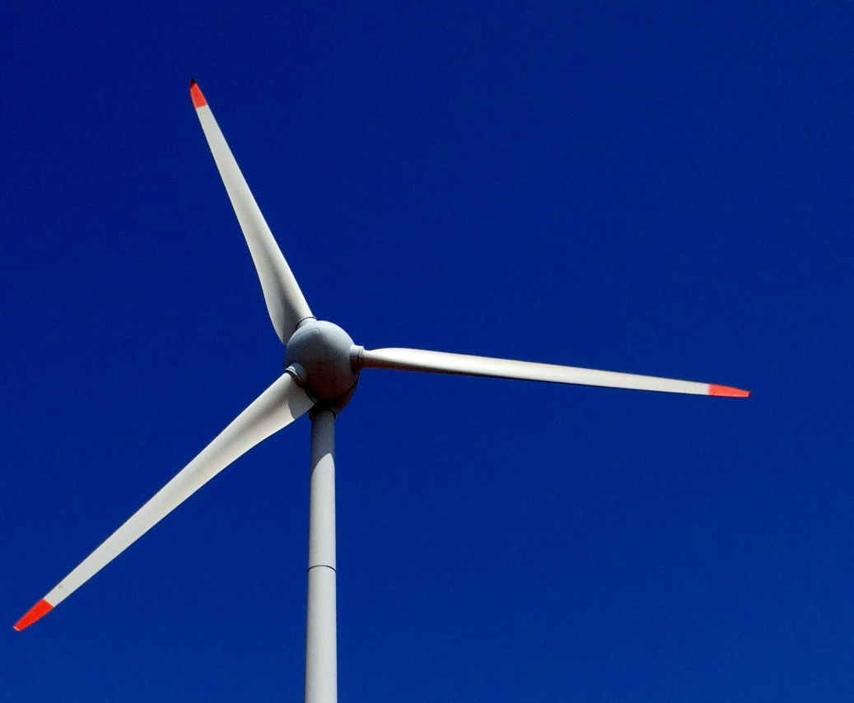
Wind Turbine Blades Fault Detection Using System Identification Based Transmissibility Analysis
Session 2 [2A10]
Xuefei Wang (speaker)
Dr. Long Zhang
Prof. William P. Heath
Department of Electrical and Electronic Engineering
School of Engineering
The University of Manchester, UK
Notes:
Good afternoon everyone and thank you all for being here.
I am Xuefei Wang, a 3rd year PhD student from The University of Manchester.
It’s my great honour to be here to present my work and I gratefully welcome any corrections. My topic today is

Slide 2
PART ONE
Introduction
Project background
Aim and objectives
Contributions
Notes:
The first part introduces the general background, main aims, objectives and contributions

Slide 3
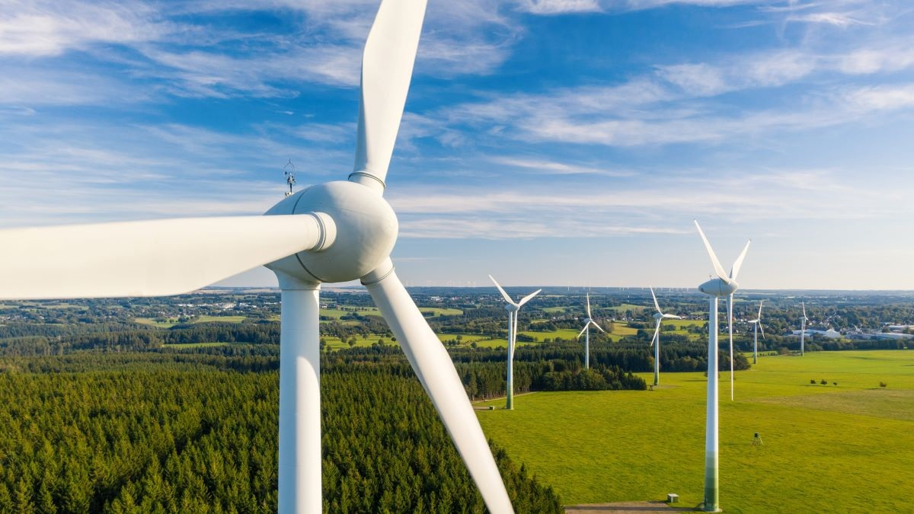
Introduction
01
Project background
General background
Conventional fossil energy has been extensively consumed and is gradually limited and in-short-supply [1].
To meet the rapid growth of worldwide energy demand, renewable energy has been contributing more energy production globally [2].
Wind power has been recognized as one of the most clean and reliable energy resources [3].
The wind turbines (WT) are increasingly deployed to convert kinetic energy into electricity, and WT blades play a vital role in capturing wind energy from nature.
Three major challenges
External nonstationary time-varying loadings (unknown or hard to obtain)
Noise from both external environment and internal equipment
Complex composite materials and complicated aerodynamic shapes
Notes:
Over the past decades, renewable energy has been contributing more to the energy production globally due to the gradually limited fossil energy and rapid growth energy demand.
Wind power is one of the renewable energy resources and WT convert wind energy into electricity. Within a WT system, the blades are crucial components to capture natural wind.
The blades failures could result in unexpected downtime and even turbine destructions, which is a significant financial loss. So, it is vital to detect the blades damage at an early stage.
Currently, there are three major challenges for blade fault detection.

Slide 4
Introduction
01
Aim, objectives and contributions
Aim
Objectives
Contributions
The main aim of this paper is to develop effective methods for WT blade condition monitoring and fault detection.
Time domain: System identification
(ARX, ARMAX, OE, nonlinear polynomial)
Output-only Transmissibility
Verified via three naturally damaged industrial WT blades serving over 15 years
Notes:
The main aim of …..
To achieve this aim, In time domain, this paper proposes a system identification-based output-only transmissibility function methods using … models. And the effectiveness of the novel methods are verified…

Slide 5
PART TWO
Literature review
Wind turbine blades
Blade failure modes
Damage detection techniques
Notes:
The second part introduces some related literature review work
Contains wind turbine blade, its failure modes and corresponding damage detection techniques

Slide 6
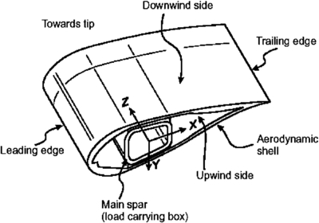
Literature review
02
Wind turbine blades
WT blades usually suffer from external nonstationary time-varying loads and are easily exposed to damages.
Flapwise loads
Bending loads
Edgewise loads
Blade loadings
Torsional loads
Acceleration
Pitch loads
Deceleration
Normal loads
Fig. 2.1: Classic WT blade structure [6]
Notes:
Within a WT system, the blades are crucial and expensive components.
The largest size of a modern WT blade reaches 88.4m which is longer than an airplane wingspan.
The left shows a classic structure of WT blade.
WT operates in harsh environment, such as remote areas or offshore sites. Wind loadings are the main loadings of the blades. Suffer…
And we can see various types of blade loadings
Within these loadings, flapwise bending loads are the main reasons for blade failure.

Slide 7
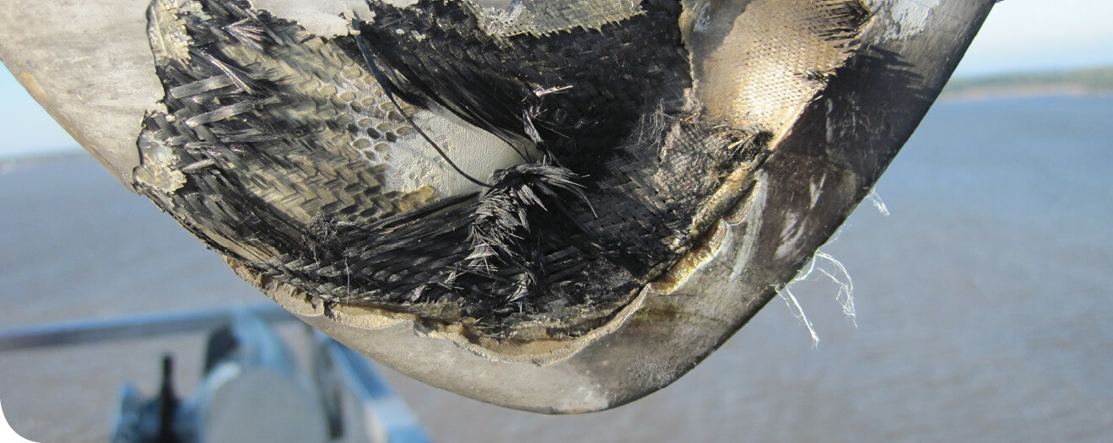
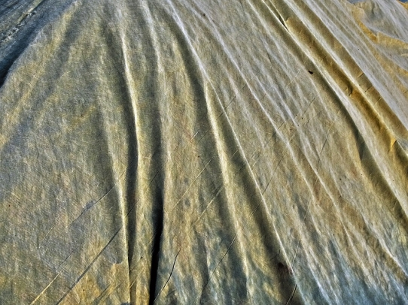
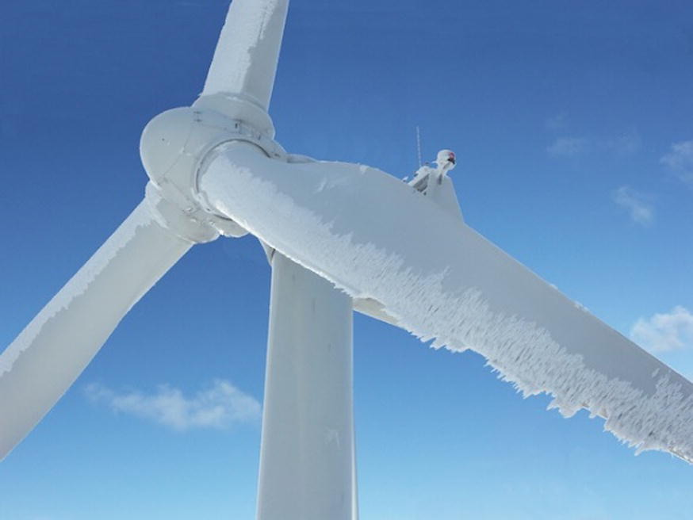
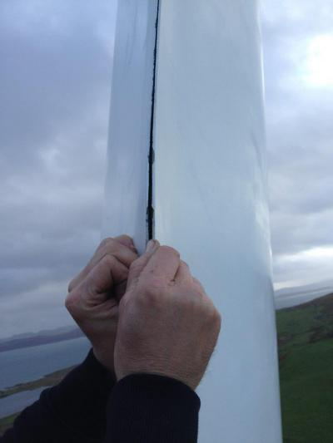
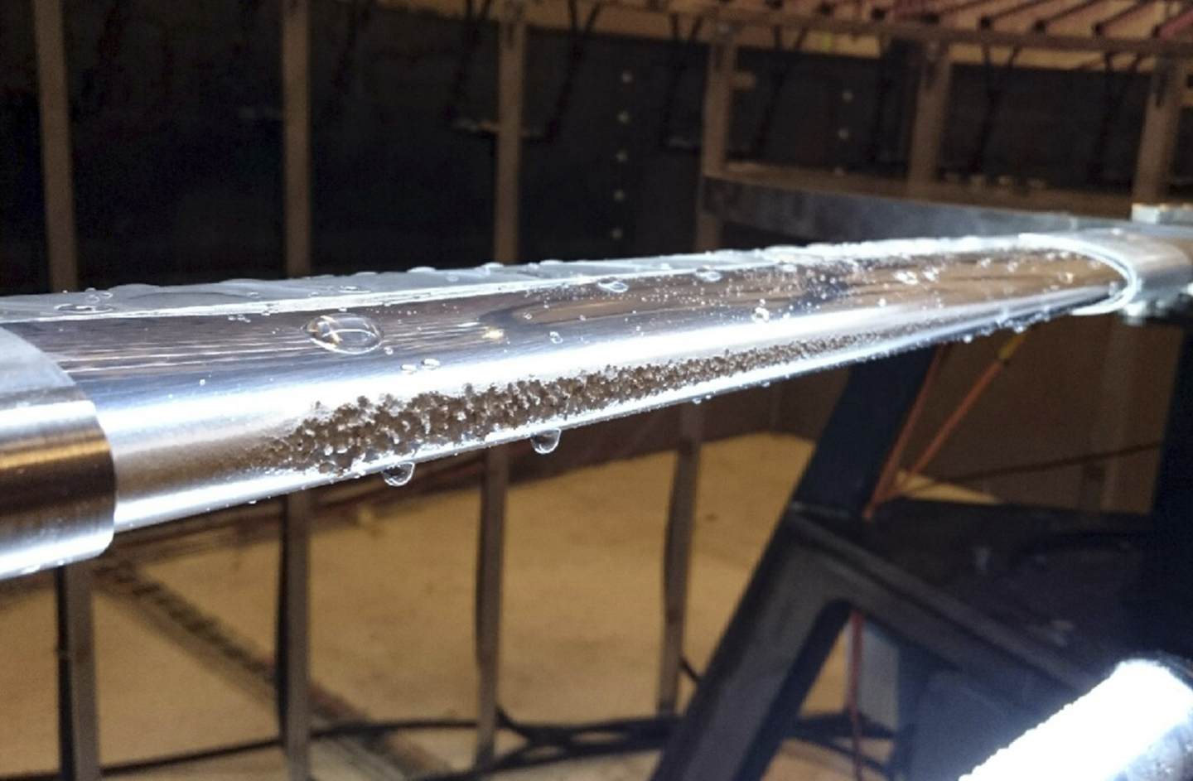
Literature review
02
Blade's failure modes
WT blade failure modes
Delamination ① | Ice/snow accumulation ③
De-bonding
 | Erosion and corrosion ④
Wrinkles ②
Buckling
 | Lightning ⑤
Brazier defects
Panel deformation
 | Dust and insect contamination
Shear failures
⑤
②
③
①
④
Fig. 2.3: Various WT blade failure modes [8-12]
Notes:
Significant fatigue loads make the blades more vulnerable to damages. This table and picture shows some common failure modes of WT blade such as…
These damages may occur during production stage or operational stage or both.

Slide 8
Literature review
02
Blade fault detection techniques
Acoustic emission
Infrared thermography
Blade fault detection techniques
Strain measurement
Vibration analysis
Ultrasonic techniques
Bending moment measurement
Notes:
The blades failures result in downtime or even turbine collapse, and they bring about significant economic loss.
Reasoning in this way, it is urgently required to detect the blade damages effectively and precisely.
Conventional nondestructive techniques have been attempted to detect blade failures. However, most of them still remain in lab stage and have not yet been implemented in real applications.
They all have their own advantages and limitations which depends on the detection requirements.
In this report, we choose vibration analysis to detect the blade faults.

Slide 9
PART THREE
Experimental setup
Notes:
This part introduces the setup of our experiments

Slide 10
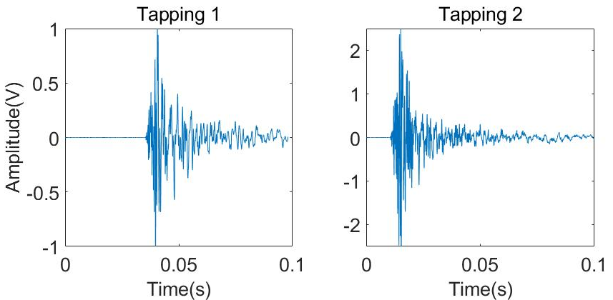
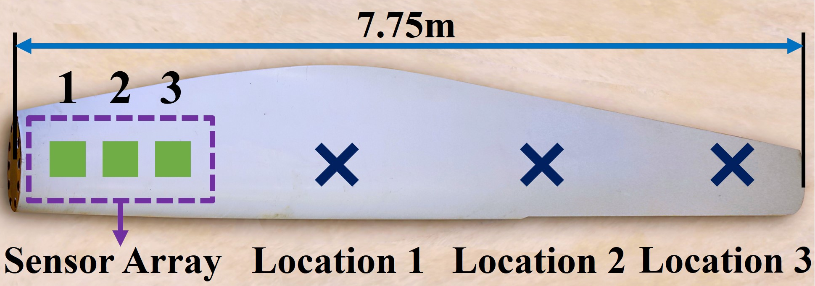
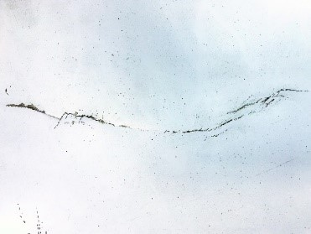
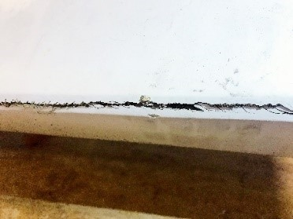
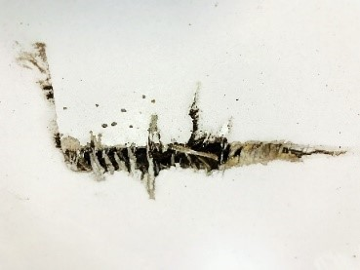
03
Experimental setup
Fig. 3.1: Schematic diagram of the experiments
Fig. 3.2: Vibration responses under two individual tappings
Three naturally damaged industrial-scale WT blades
Blade #1: healthy
Blade #2: defective
Blade #3: defective
(a) Surface crack
(b) Lateral crack
(c) Skin delamination
Fig. 3.3: Damages pictured within the test region of blade #2 & #3
Notes:
Fig. 3.1 shows how the experiments are conducted.
A sensor array comprised of three vibrational sensors are mounted at the root surface of the blade.
There are three excitation locations.
The raw data measured from two individual hammer tappings are presented in fig. 3.2, which represents two typical vibrational response signals,
It shows different tappings produce different responses at diverse amplitudes.
Fig. 3.3 presents the observed damage pictures taken from defective blade no.2 and 3.

Slide 11
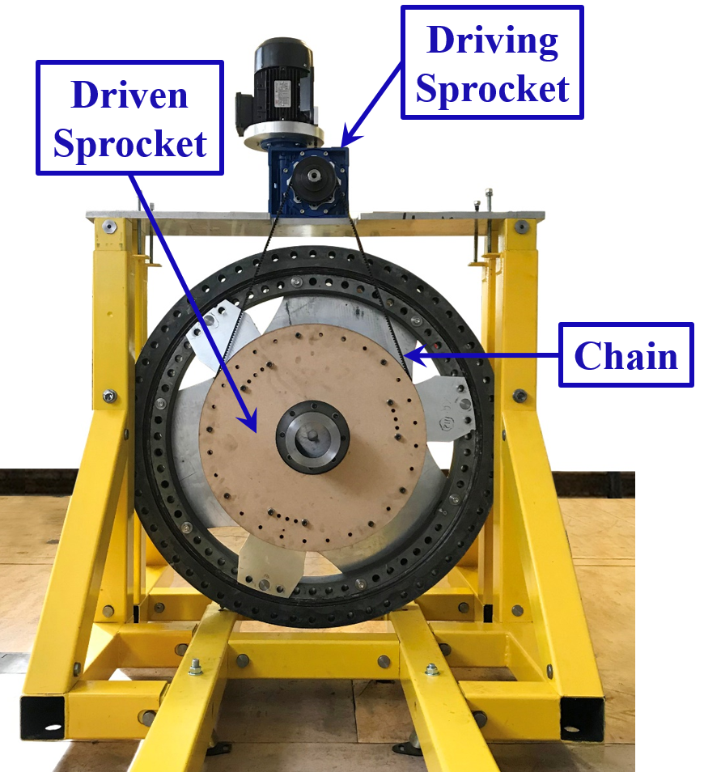
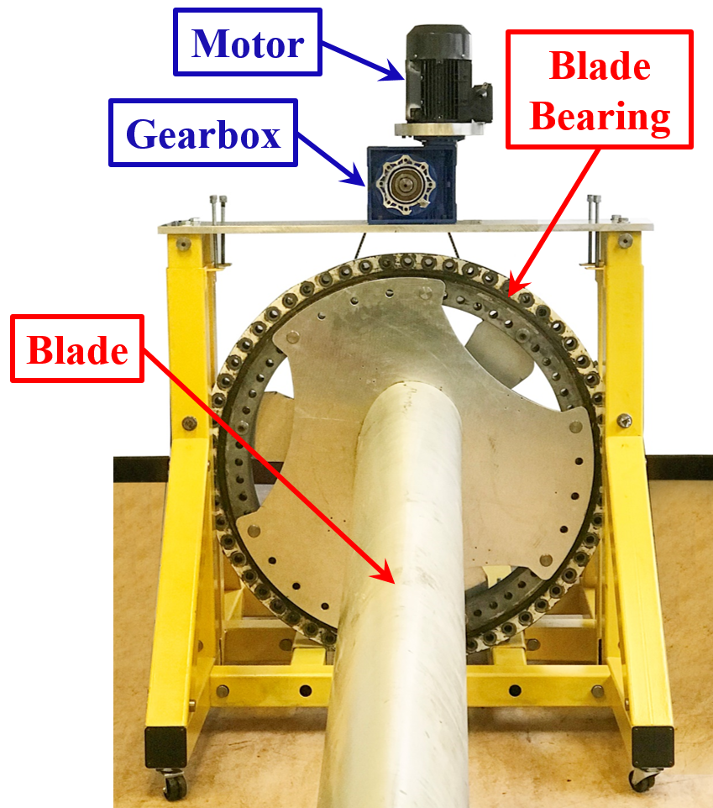
Experimental setup
03
Integrated test-rig tests
The blade is integrated to the pitch systems with blade bearing and driving actuators (including pitch motor and gearbox)
(a) Back view
(b) Front view
(c) Overall view
Fig. 3.4: Integrated test-rig setup
Notes:
To investigate the feasibility of the proposed techniques in practice,
The blade is ….
Fig…. Shows the configuration of the test-rig including both back and front view.

Slide 12
PART FOUR
Wind turbine blade fault detection
Time-domain system identification-based TF methods
Notes:
Based on the raw data collected from the experiments, we use time domain Transmissibility function methods for blade fault detection

Slide 13
04
System identification TF methods
04
Input excitation
Output response
Multiple Output responses
System identification methods
Regularization
Regularization is introduced to simplify the models and address the overfitting issues.
Linear models
Nonlinear models
ARX
ARMAX
OE
Polynomial
Notes:
In time domain , we apply system identification methods to detect the blade failures.
Novelty…
And we use both linear and nonlinear models to represent the relationship between multiple outputs.
Model can be over parameterized. Parameters are in high level uncertainty
A penalty term is added into the cost function to deal with the overfitting

Slide 14
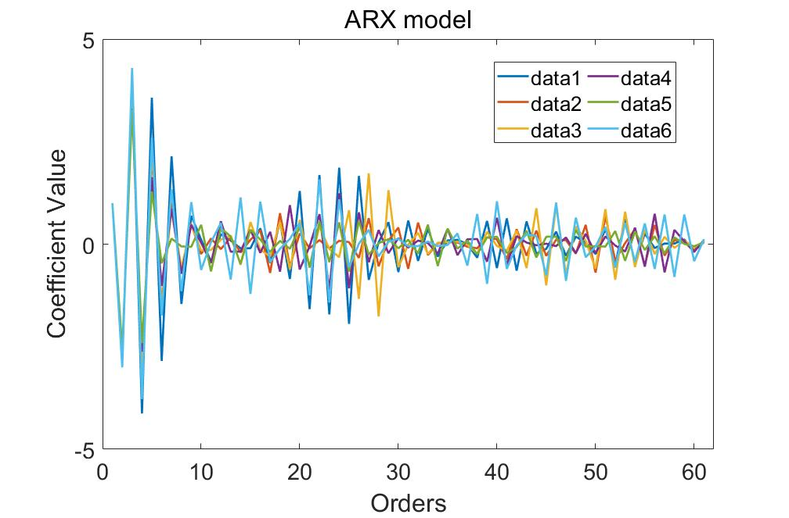
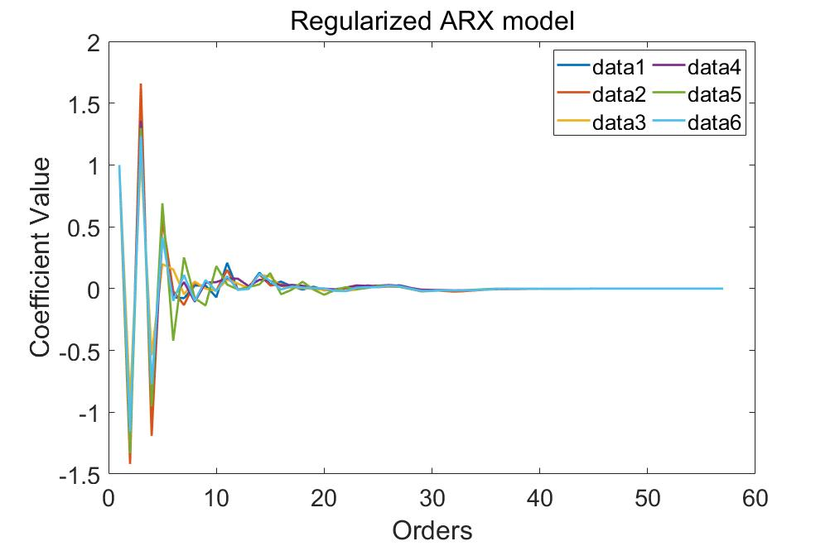
04
System identification TF methods
Fig. 4.1: A(z) coefficients of ARX and regularized ARX models
Notes:
High order coef are penalized to almost zero due to the regularization.

Slide 15
04
System identification TF methods
Table 1: Sum squared of coefficients with variations of three blades under 6 individual tappings
Models | Blade #1 | Blade #2 | Blade #3
 | (healthy) | (defective) | (defective)
ARX | 3.28±0.58 | 5.79±0.77 | 5.04±0.69
Regularized ARX | 2.95±0.21 | 4.93±0.37 | 3.82±0.16
ARMAX | 2.85±0.97 | 3.84±0.69 | 3.33±0.81
Regularized ARMAX | 1.02±0.29 | 0.97±0.41 | 1.03±0.09
OE | 5.19±0.56 | 3.82±0.34 | 3.27±0.71
Regularized OE | 2.51±0.30 | 1.68±0.42 | 1.71±0.22
Nonlinear | 5.59±0.91 | 4.87±0.77 | 5.64±0.66
Regularized Nonlinear | 2.12±0.39 | 2.06±0.41 | 2.26±0.50
Notes:
Table 1 displays the sum squared model coefficients for the three WT blades. These coefficients correspond to the poles locations of the blade system, and these poles determine the properties and behaviors of the blade structure system. The results show that regularized models deliver more consistent and robust coefficients and is immune to noise.

Slide 16
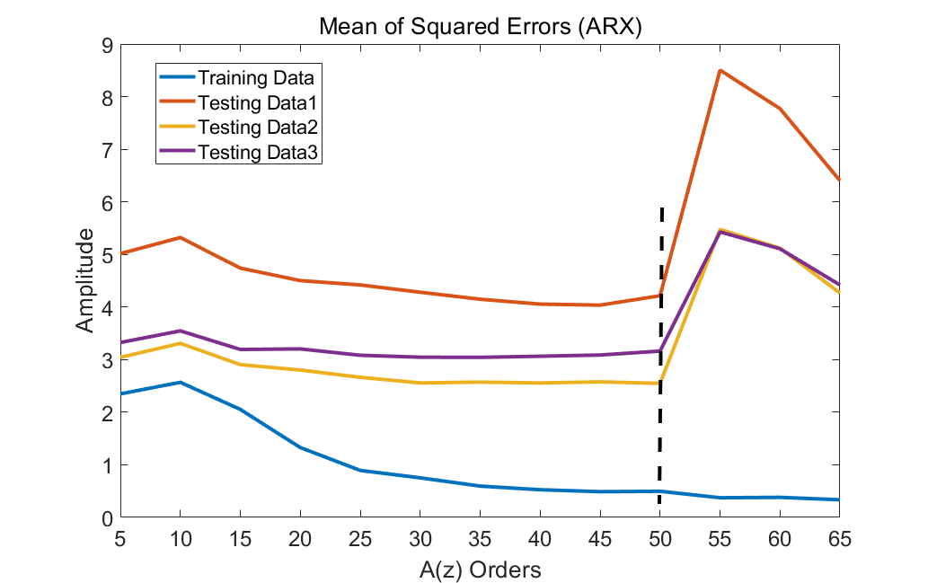
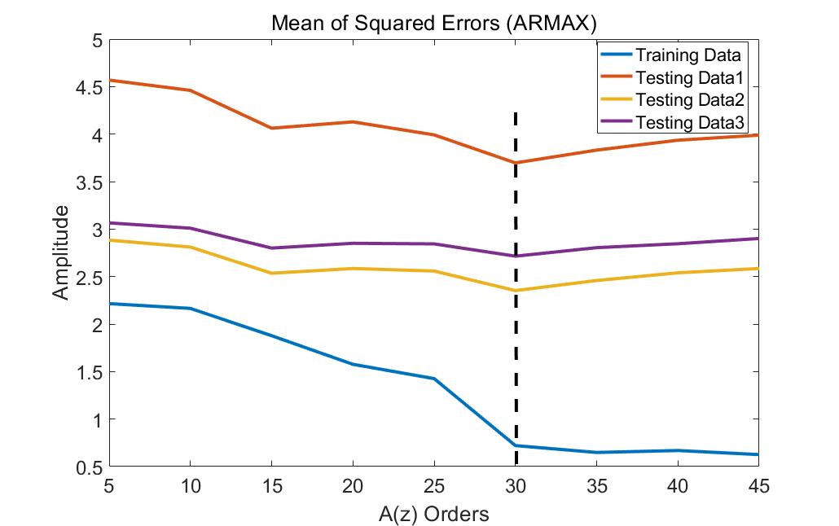
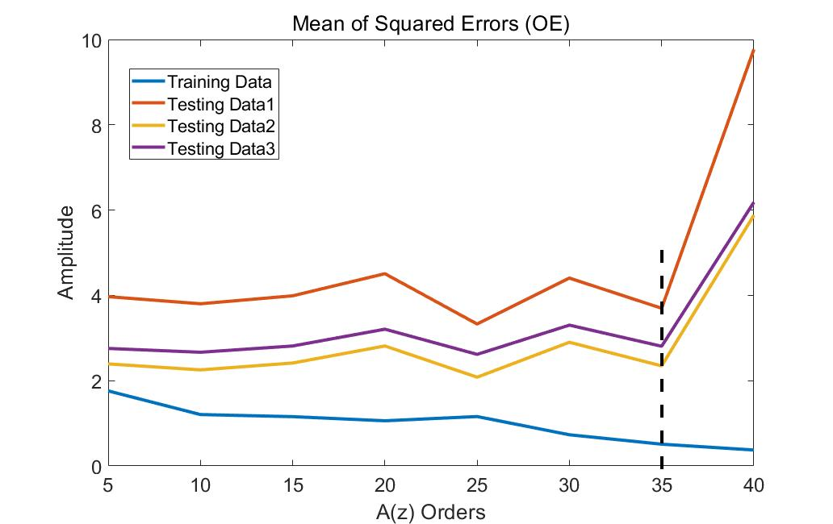
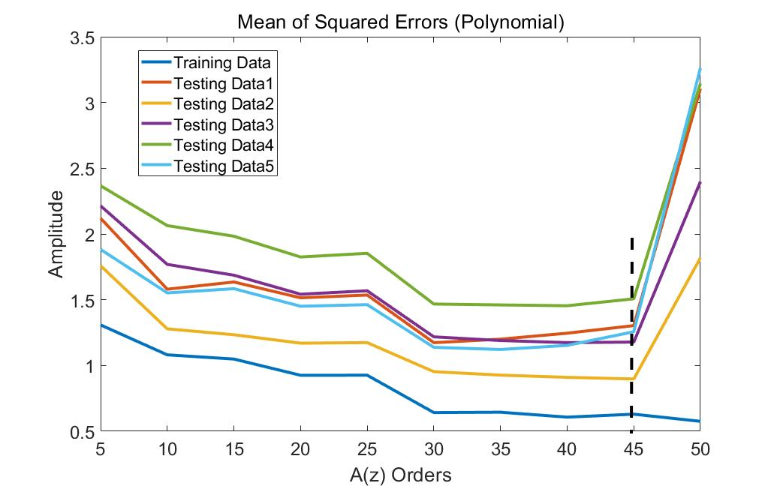
04
Validation:
Training data
testing data
Fig. 4.2:
Validation of ARX, ARMAX, OE and nonlinear polynomial models
Notes:
Training data and testing data…
Mean of squared errors between model output and the measured response.
Exceedingly high orders result in overfitting issues

Slide 17
Notes:
This figure depicts the results of both ARX and its regularized models as an example.
Compared to the ARX results, the regularized ARX results are less sensitive to the low amplitude oscillation and make them capture the main trend of the response well. This is mainly due to the sparser and lower order model with a smaller number of coefficients when using the regularized technique.

Slide 18
04
System identification TF methods
Table 2: Fitting percentage of three blades using four different model types
% | Blade #1 | Blade #2 | Blade #3 | Rank
 | (healthy) | (defective) | (defective)
ARX | 63.46 | 66.34 | 63.13 | 2
ARMAX | 56.61 | 58.31 | 57.43 | 3
OE | 55.53 | 41.27 | 67.49 | 4
Nonlinear | 79.06 | 76.99 | 75.82 | 1
Notes:
The regularized methods are used to estimate all the four model parameters.
Table 2 displays the system identification results of all the four aforementioned models on training data sets. The fitting percentage of nonlinear ARX model is around 78%, which is higher than the ARX model, ARMAX and OE model.
This indicates that through comparison, the nonlinear polynomial model has the best fitting percentage among these four types of model, which may indicate that the nonlinear polynomial model is able to capture the nonlinearities of the WT blade structure and expresses the blade system property better than the other models.

Slide 19
04
System identification TF methods
Table 3: Mean correlations with mean variations between the three blades
Models | Blade #1 | Blade #2 | Blade #3
 | (healthy) | (defective) | (defective)
Nonlinear | 0.958±0.087 | 0.588±0.071 | 0.391±0.093
ARMAX | 0.935±0.022 | 0.735±0.019 | 0.612±0.067
OE | 0.877±0.041 | 0.660±0.062 | 0.538±0.017
ARX | 0.962±0.047 | 0.747±0.021 | 0.555±0.057
Results | Reference | Less damage | Severe damage
Notes:
To further quantify the damage levels, Table 3 shows the mean correlations with mean variations of blade 2 & 3 with respect to the reference blade 1 under 6 individual tapping experiments.
Results show that all the presented models can identify the defective blades and also indicate damage level. However, among the given models, the linear ARX models express more robust results and presents clearer damage levels than other models. It is hence better to choose ARX model as damage indicator tor WT blade fault detection.

Slide 20
PART FIVE
Conclusions
Notes:
The last part concludes the whole paper.

Slide 21
05
Conclusions
Conclusions
system identification-based Transmissibility Function (TF) methods
ARX, ARMAX, OE and nonlinear ARX polynomial model
Regularization, overfitting issues, noise rejection ability
Remove the impacts of excitation loads
Nonlinear ARX model delivers the best fitting percentage
ARX model acts as the best damage indicator
Notes:
This paper proposes system identification-based Transmissibility Function (TF) methods to wind turbine (WT) blade Condition Monitoring and Fault Diagnosis (CMFD). Four different models including (ARX) (ARMAX) (OE) nonlinear ARX polynomial model are tested respectively. Regularization is carried out for the four aforementioned models to avoid overfitting issues, and futher enhance the noice rejection ability of the proposed methods. Results show that the proposed methods can remove the impacts of excitation loads, and although nonlinear ARX model delivers the best fitting percentage and can indicate damage levels, the ARX model acts as the best damage indicator among the four models.

Slide 22
References
Elise Dupont, Rembrandt Koppelaar, and Herve Jeanmart. Global available wind energy with physical and energy return on investment constraints. Applied Energy, 209:322-338, 2018.
Peter Enevoldsen, Scott Victor Valentine, and Benjamin K Sovacool. Insights into wind sites: Critically assessing the innovation, cost, and performance dynamics of global wind energy development. Energy policy, 120:1-7, 2018.
R Saidur, MR Islam, NA Rahim, and KH Solangi. A review on global wind energy policy. Renewable and sustainable energy reviews, 14(7):1744-1762, 2010.
Willy Tjiu, Tjukup Marnoto, Sohif Mat, Mohd Hadz Ruslan, and Kamaruzzaman Sopian. Darrieus vertical axis wind turbine for power generation i: Assessment of darrieus vawt congurations. Renewable Energy, 75:50-67, 2015.
Abhishiktha Tummala, Ratna Kishore Velamati, Dipankur Kumar Sinha, V Indraja, and V Hari Krishna. A review on small scale wind turbines. Renewable and Sustainable Energy Reviews, 56:1351-1371, 2016.
MJ Sundaresan, MJ Schulz, and A Ghoshal. Structural health monitoring static test of a wind turbine blade. 2002.
Nikolaos Dervilis, M Choi, Igeneia Antoniadou, KM Farinholt, SG Taylor, Rob J Barthorpe, G Park, Charles R Farrar, and Keith Worden. Machine learning applications for a wind turbine blade under continuous fatigue loading. In Key Engineering Materials, volume 588, pages 166-174. Trans Tech Publ, 2014.
Graeme Jenkins. Wind turbine blade claim-luning october 2014. http://nsurerenewables.co.uk/tag/delamination/. Accessed July 15, 2019.
Owners Roundtable Wind 2018. Managing manufacturing defects on blades. http://www.owners-roundtable.com/roundtables/s2-defects-on-blades-35861270. Accessed July 15, 2019.
Paul Dvorak. If blades are a key turbine component, why not treat them that way? https://www.windpowerengineering.com/business-news-projects/featured/blades-key-turbine-component-no-treat-way/. Accessed July 15, 2019.
Carlos Quiterio Gomez Munoz, Fausto Pedro Garca Marquez, and Juan Manuel Sanchez Tomas. Ice detection using thermal infrared radiometry on wind turbine blades. Measurement, 93:157-163, 2016.
LM Wind Power. On the leading edge: Innovative solutions to reduce rain erosion. https://www.lmwindpower.com/en/stories-and-press/stories/innovation/on-the-leading-edge. Accessed July 15, 2019.

Slide 23
Thank You
Session 2 [2A10]
Monday 14 June 2021
Authors : Xuefei Wang, Dr. Long Zhang and Prof. William P. Heath
Email: {xuefei.wang, long.zhang, william.heath}@manchester.ac.uk
Address: The University of Manchester, Oxford Rd, Manchester, UK, M13 9PL
Notes:
And that’s the end of my report. Many thanks for your listening, and please feel free to ask me questions or provide any corrections?

